Slide 1
E-Commerce iWorld WEBSITE
Task-4

Slide 2

ASTROLOGY WEBSITE
The website provides the same generic zodiac sign insights to all users, regardless of their birthdate or other personal details. This one-size-fits-all approach fails to resonate with users, as they seek content that is tailored to their unique personality traits and life circumstances.
LMS Username | Name | Batch
au721220104029 | Nusrat Jahan | Cd1_4
au721220104038 | Rishma | Cd1_4
au721220104049 | Sowmya | Cd1_4
au721220104063 | Yagavi | Cd1_4

Slide 3
Task - 2
Create UI and implement various components using react
Split design into components and Higher order Components
Define structure of the components
Set the basic ui components with dummy data
Integrate the APIs to frontend to ensure the dynamic feature of website
Point base api to the severs base url
Design api calls for each element
Handle errors in the output
Render output of apis to different low level components
Secure content of post apisx
Evaluation Metric:
100% Completion of the above tasks
Learning Outcome
Developing complicated UI using react components
Using props drilling and context to pass variables
Getting familiar with different type of api calls
Handling different input data

Slide 4
Step-Wise Description
Requirements: Need to offer iPhones at a lower price with the same model on the release day.Improve customer support and address user inquiries about the product.
User Data Collection: Collect user data for market research and customer profiles.Gather data on user questions and issues with the iPhone purchase process.
E-commerce Insights:Analyze e-commerce data to identify pricing strategies for offering iPhones at lower prices. Monitor user behavior on the website for optimization.
Fact-Checking: Verify the accuracy of product information on the website. Ensure that all claims about iPhone models and prices are truthful and up-to-date.
Content Management: Maintain a well-organized and updated website with accurate product information. Manage customer reviews and feedback effectively.
Technology Stack: Use PHP, JavaScript, and MySQL for web development, we use React JS for the front-end
User Data Collection: Create a user-friendly interface to buy different iphone in affordable price.
.
Summary of your task
To meet customer demands, iPhone-Apple(IN) aims to provide the latest iPhone models at lower prices on release day, but currently lacks effective customer support. To achieve this, they need to collect user data for market research and address user inquiries. This requires analyzing e-commerce data for pricing strategies and maintaining accurate information on their website. Ensuring the veracity of product details and managing content is vital. Additionally, they should conduct testing and deploy updates as necessary to enhance their e-commerce platform and customer support systems.

Slide 5
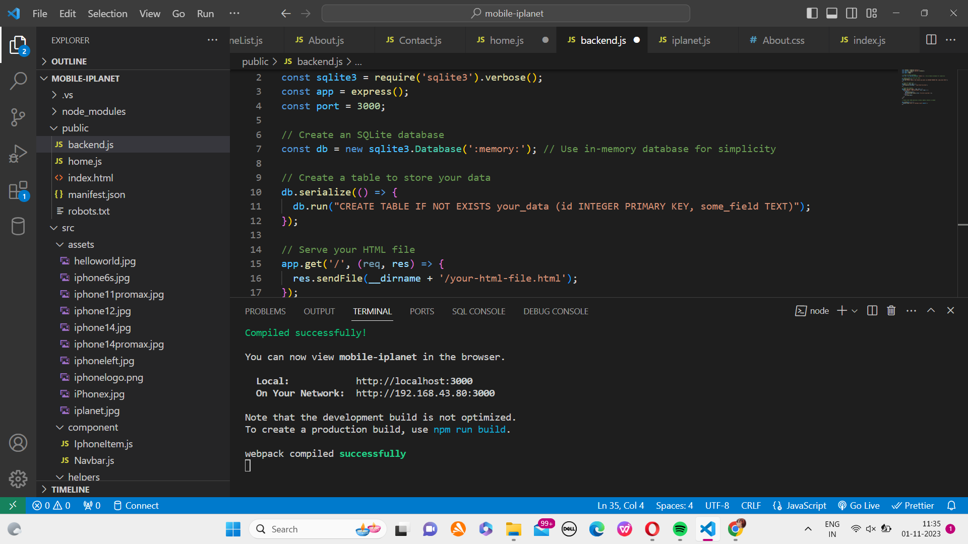
Progress Screenshot- BACKEND

Slide 6
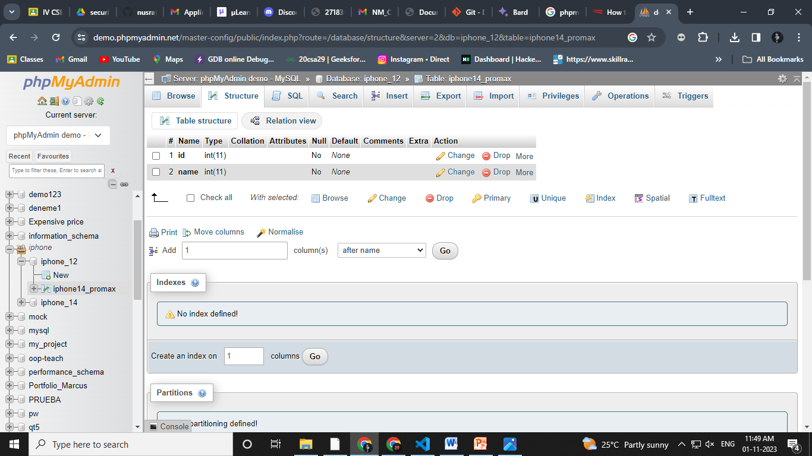
Progress Screenshot- BACKEND

Slide 7
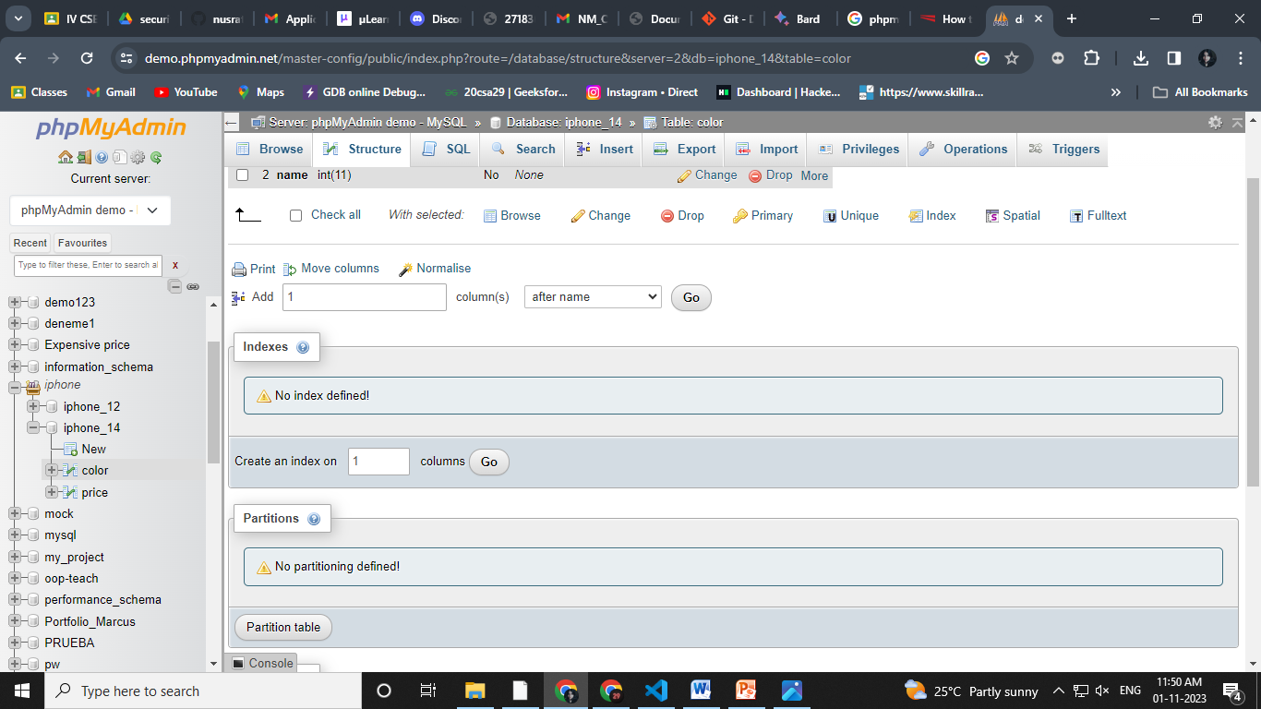
Progress Screenshot- BACKEND

Slide 8
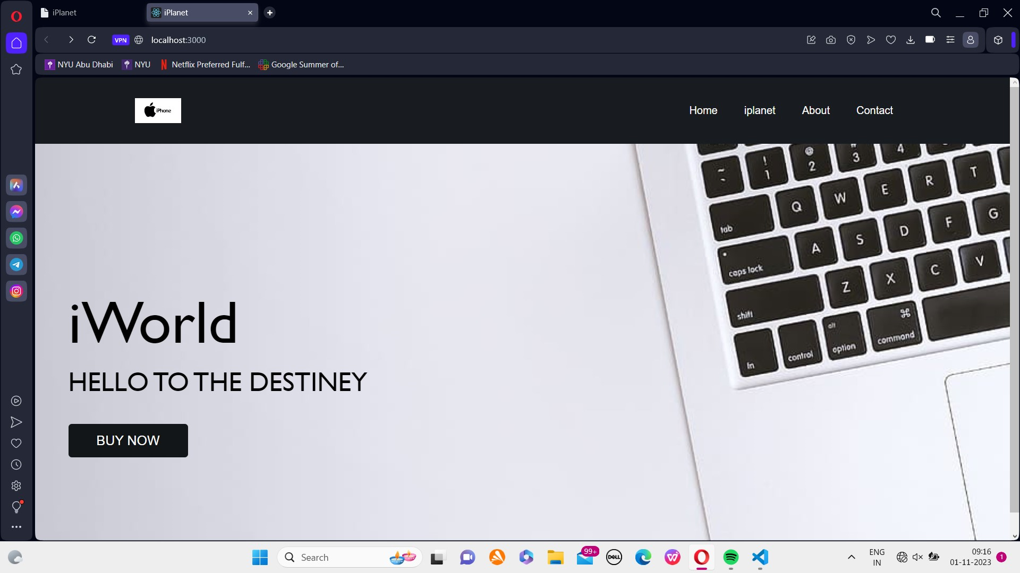

Slide 9
Assessment Parameter
Setup Project for Calculator project
Setup basic structure of text-editor project
Create a main component with the outer structure of calculator
Check-List
Create main component with all feature buttons
Create a button component with on click handler
Create a json object to store data for text editor
Create a ` evaluateExpresion` function to evaluate value
Push both code to github

Slide 10
Submission Github
https://github.com/Yagavi17/Task4_BackEnd https://github.com/RishmaRamesh/Task4_BackEnd https://github.com/Sowms02/Task4_BackEnd https://github.com/nusrat160nj/Task4_backend

